Slide 1


SAP UI5 & FIORI with OData TRAINING using BAS
Anubhav Oberoy
Day – 12

Slide 2

Agenda – Day 12
Understanding the CORS Policy Issue
Integrating the OData in Fiori App
Binding our app with Odata properties
Supporting the Pagination
Getting the Associated Data
Making the POST call using the UI
Making Update call from UI
Making Delete call from UI
Calling the Function Import in the UI
Delivering our Fiori App
Adding deployment Configuration to our app
Deploying our app to the SAP ABAP Repository
Introduction to Git Hub
Understanding How GitHub Works
Steps to Create a Git Repository
Adding our Project to Git Repository

Slide 3
Add.controller
Add.view
{
"PRODUCT_ID" : "AB-9091",
"TYPE_CODE" : "PR",
"CATEGORY" : "Notebooks",
"NAME" : "Notebook Basic 15",
"DESCRIPTION" : "Anubhav new Supersonic laptop",
"SUPPLIER_ID" : "0100000046",
"SUPPLIER_NAME" : "SAP",
"TAX_TARIF_CODE" : "1 ",
"MEASURE_UNIT" : "EA",
"PRICE" : "956.00",
"CURRENCY_CODE" : "EUR",
"DIM_UNIT" : "CM",
"PRODUCT_PIC_URL" : "/sap/public/bc/NWDEMO_MODEL/IMAGES/AB-9091.jpg"
}
Local model
Same format what we need to send to odata
Id
Name
price
odata
SAP Server

Slide 4
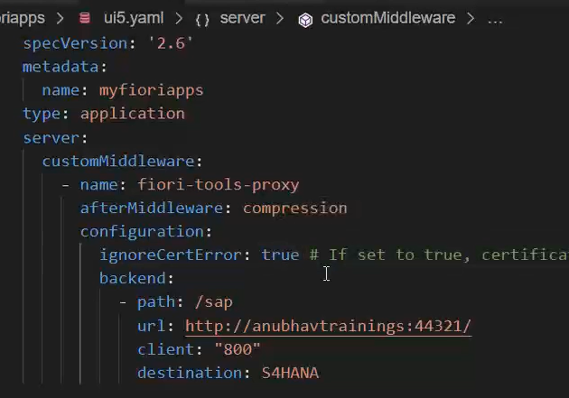
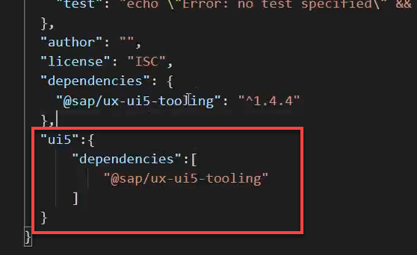
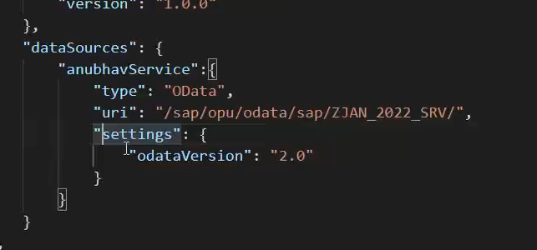
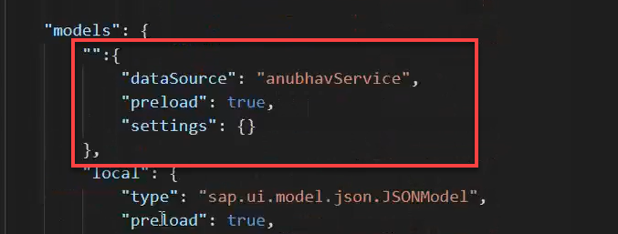
Integrating OData in Fiori App
Before we start OData integration in our fiori project we need have to check that, we have added the package.json and ui5.yaml file in our project, if the we haven’t add then run these commands in the terminal to added these files:
npm init
ui5 init
Now we have the required file in the project, we can proceed the integration.
Go to ui5.yaml file and add the middleware code (given in the link) to the file and save it.
Add the dependency of sap/ux-ui5-tooling to the project using the command: npm install @sap/ux-ui5-tooling
Now add the ui5 section in the package.json file to specify the dependencies related to ui5.
Now go to the manifest.json file we have to add a dataSource under the sap.app section and then create a default model to consume the service in UI.

Slide 5
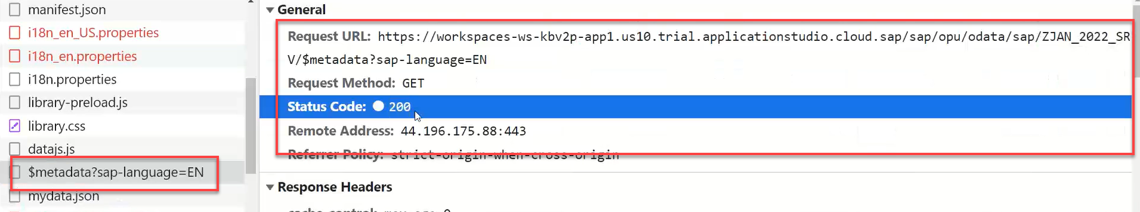
Hands – on: Consume OData service
Follow the steps given in the previous slide to configure the fiori app in BAS to consume the Odata service.
Once the configuration is complete the app will call the metadata of the application which we can check in the Network tab in browser.
Code Link:-
ui5.yaml
package.json
manifest.json

Slide 6
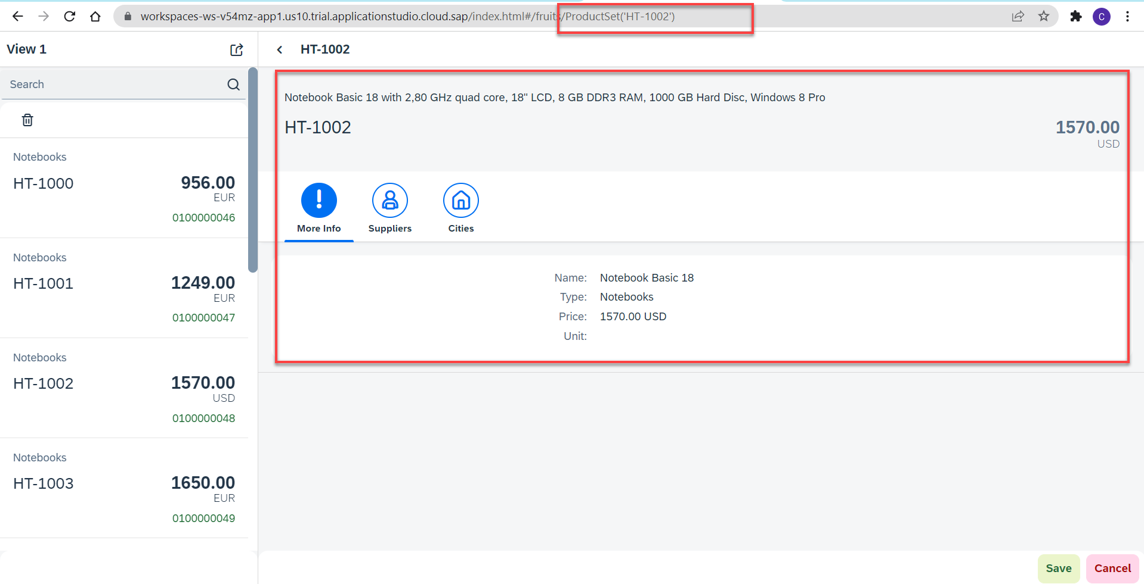
Hands – on: Binding the app with odata
Now to get the data into the application we have to change the binding of the application. Initially the app is bind to the fruits data, so we have to bind it form the OData properties.
We also have to change the Route Match Handler (herculis) code in the View2 controller.
We have to add the growing property to the list to support pagination.
And we also have to change the search function to support the filter on the CATEGORY.
Code Link:-
View1.view.xml
View1.controller.js
View2.view.xml
View2.controller.js
moreInfo.fragment.xml

Slide 7
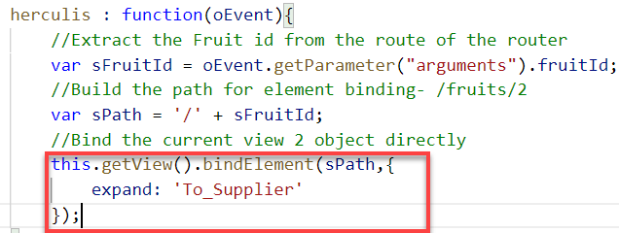
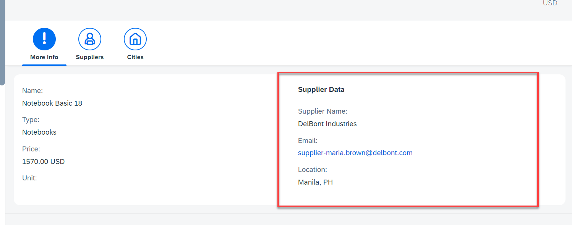
Hands – on: Getting the Associated Data
Now we want load the associated data on the UI. To do that we will create a new form in the moreInfo Fragment and in that form we will load the Supplier data of the product.
We will also have to make some changes in the Binding of the View2 to load the dependent data.
Code Link:-
View2.controller.js
moreInfo.fragment.xml

Slide 8
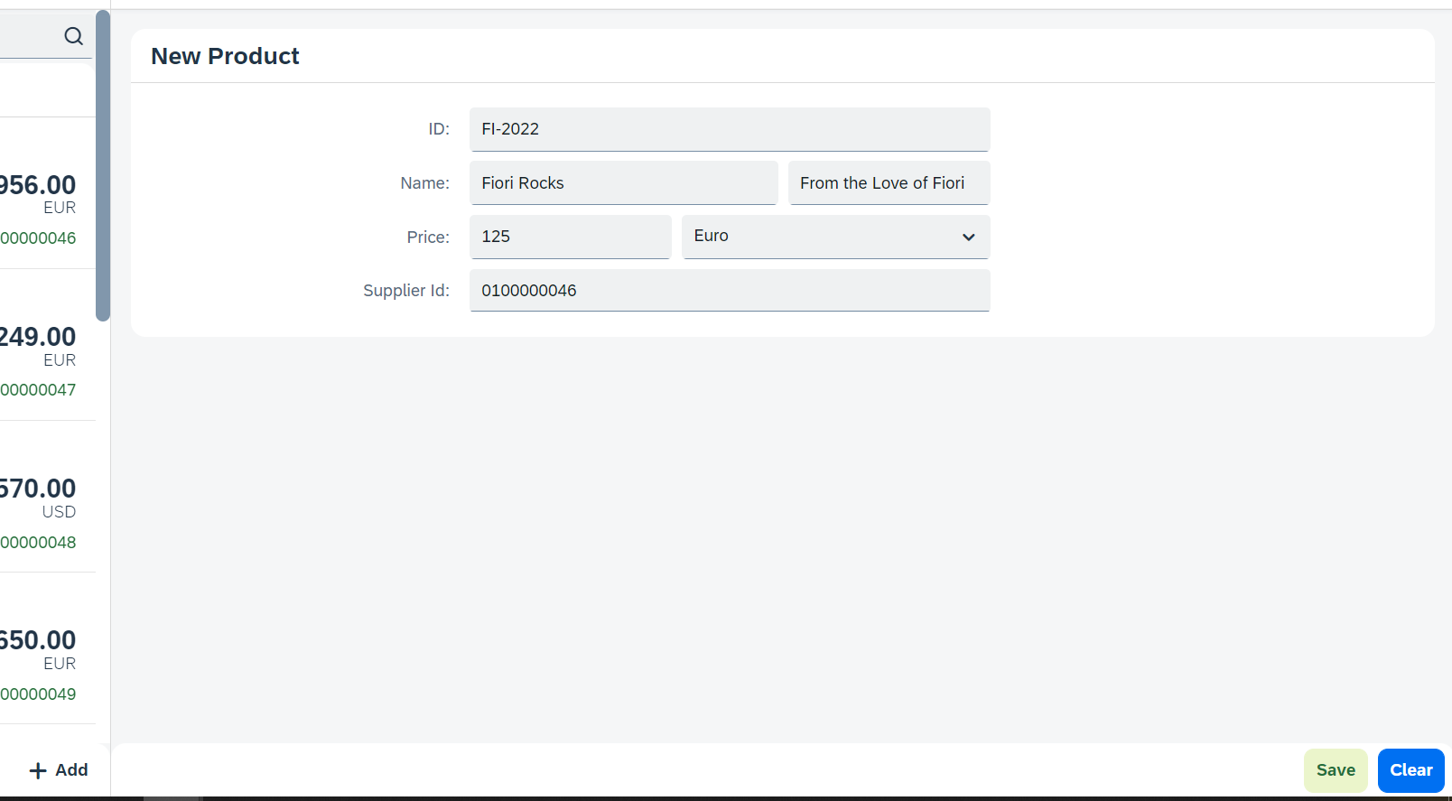
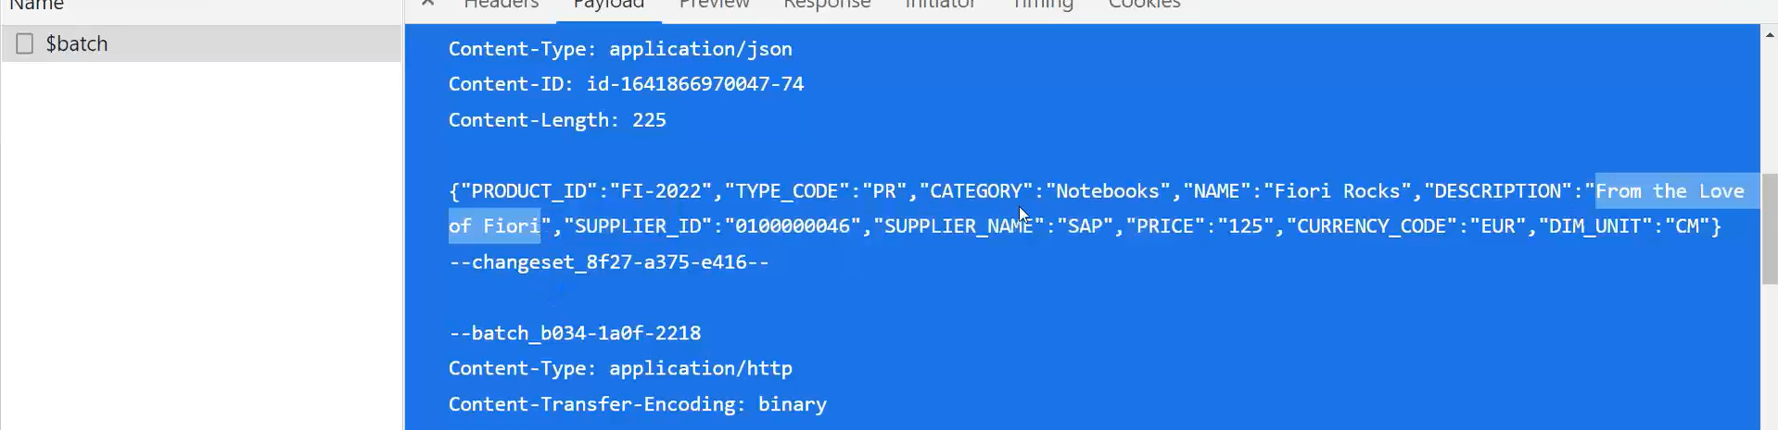
Hands – on: Making POST call from UI
Now we will add a new view named as Add. In this view will add a simple form to enter the product details and then on press of the Save a new Product will be created in the backend.
We will also add a Clear button to clear the form.
Code Link:
View1.view.xml
View1.controller.js
Add.view.xml
Add.controller.js
manifest.json

Slide 9
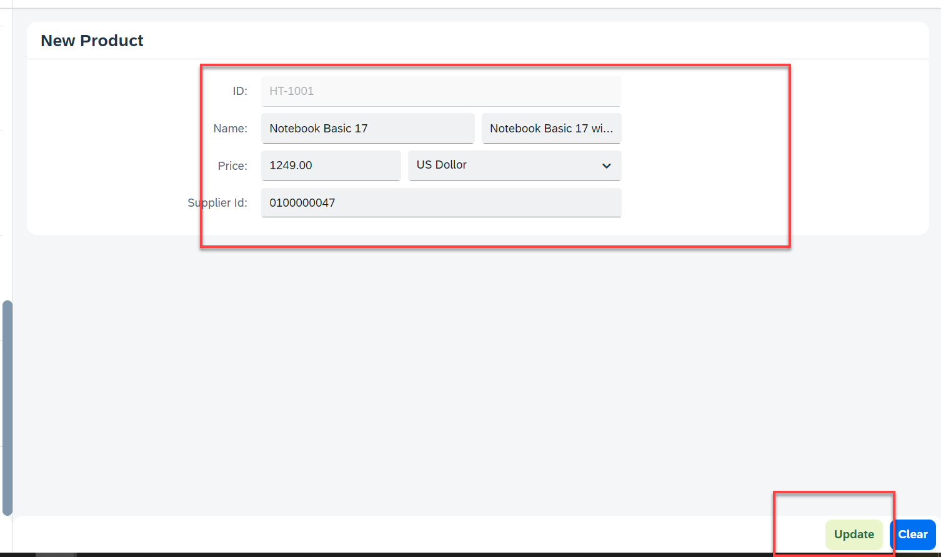
Hands – on: Making Update call form UI
Now will add a functionality to update a Record form the backed. But before that we will have to load the record in the form and then we will update that recode and save it.
Code Links:-
Add.view.xml
Add.controller.js

Slide 10
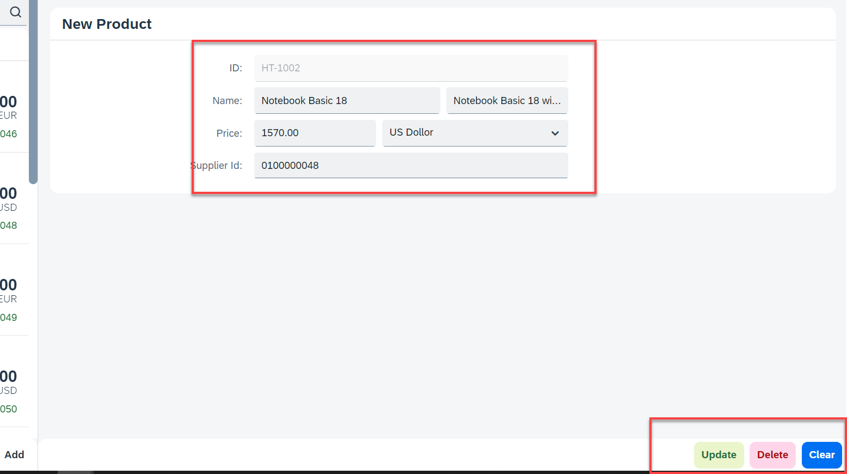
Hands – on: Making Delete call from UI
Now we want to delete a selected record form the UI. To do that we have to make a delete button in the UI and on press of that delete button the record will be deleted form the backend.
Code Links:-
Add.view.xml
Add.controller.js

Slide 11
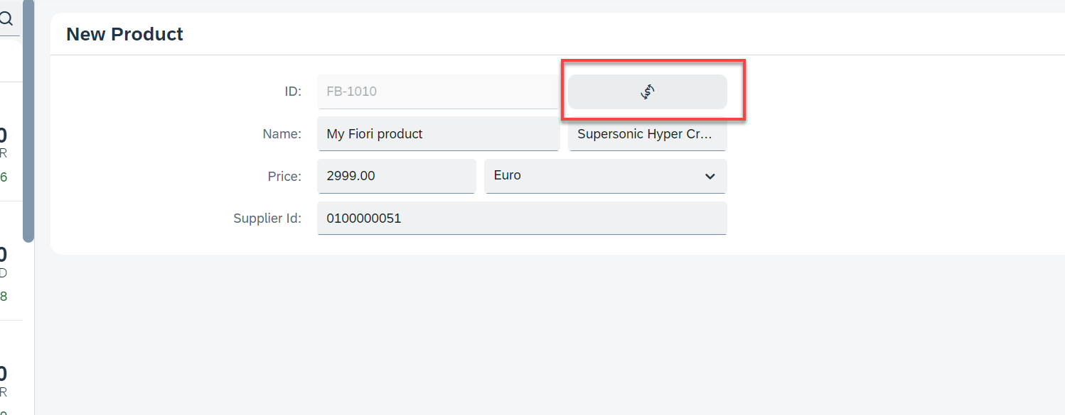
Hands – on: Calling the Function Import
Now load the most expensive data on the Add View. To do that we will add a button next to the Product ID field and on press of that button we will make a call to the Most Expensive Products function which we have created. And then load the data into the form.
Code Link:-
Add.view.xml
Add.controller.js

Slide 12
Delivering Fiori Apps
Currently the Application we have developed is in our local system (VS Code or BAS). Now we want this app to be accessible by other people in our company, to do that we have to deploy this application to our ABAP environment or cloud platform where it can be accessed by others.
BAS/VS Code
GitHub
Development Team
destination
SCC
DEV
QLT
PROD
BSP App
BSP App
BSP App

Slide 13







Delivering Fiori Apps
2
ui5 build
Development Environment
(BAS, VSCode, etc.)
1
git push
dist
GitHub Repository
3
npm run deploy-config
Developer
deployment configuration
End Users
4
npm run deploy
ABAP Repository
PROD (P)
DEV
Quality(Q)
Transport Request
Transport Request
Admin
Launchpad and Launchpad Designer

Slide 14
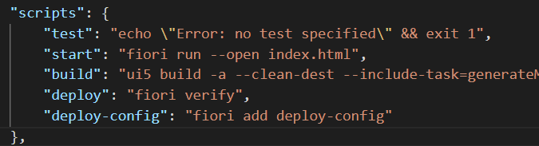
Adding deployment Configuration to App
Steps to configure the Application to deploy the Application on ABAP Environment.
Open the terminal in BAS or VS Code and go to your project folder.
Open terminal in you project folder.
Write command ui5 build or npm run build and press enter to build your project it will create a dist folder.
Now write command npx fiori add deploy-config to configure the project for deployment.
Select a target ABAP system … http://103.207.171.202 in your case your hostname will come in this step.
Enter the ABAP system client number …
Enter a username …
Enter a password …
Enter an application name …
Enter a description for the application …
Enter a package for the deployed application … $TMP
Now to deploy the application to the ABAP repository we use the command npm run deploy.

Slide 15

Introduction to Git and GitHub
Git is a version control system that lets you manage and keep track of your source code history.
GitHub is a cloud-based hosting service that lets you manage Git repositories.
Git HUB is a central repository to store all the code. Git is a distributed repository management system, which allows development teams to organize and sync their development code.
Use Case- I am working as a Fiori Developer in an MNC and I want to share my code with fellow developers, currently I am downloading the zip/tar file and sharing over email.
This way we will have piles of emails in our account,
especially when we work in a team of size 40 developers it becomes very hard to sync changes.
There is version control. Last night my app was stable, I made some changes this morning which messed up the whole project. I some how pray to god that can you please take me in past.
In a big team, many developers touching each other’s code and it’s hard to blame someone who disrupt the code.
It is also very hard to merge changes when done in same file.
As a developer, I am using BAS today, tomorrow I will use VS Code and next day Web IDE and very next week Atom. How can I easily port my code between these tools.
You can install git in local machine using below link (however, it comes along with all dev tools)
https://git-scm.com/downloads

Slide 16


How GitHub Works and commands in Git
We will see some important commands related to Git and will see how GitHub works.
Some important commands to use git.
git Init: It is used to initialize a new Git Repository in the system.
git add <filename>: It is used to stage the changes of the file to git repository. We can use ‘git add .’ to stage the changes of all files.
git commit: It is used to commit all the staged changes with a message.
git reset hard: Discard all the staged changes and discard the changes in all the files.
git push: It is used to push all the changes in the git repository.
git pull: It is used to pull the new changes made by other users in the project.
git status: It is used to check the status
git clone: It is used to clone a repository.
git remote add <repo URL>: Add a local repository to a remote repository.
Fiori Project (or any kind of project)
User (Sakshi)
But how all users will work on the project at a same time?
Sakshi’s local machine
Here GitHub comes into picture
Users which are working on the different parts of the same project on different Platforms (BAS, VS Code, Web IDE)
Project Repository
The project will be kept in a repository in the GitHub

Slide 17
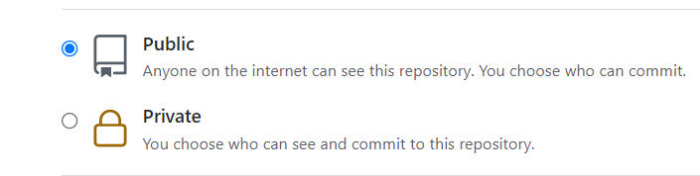
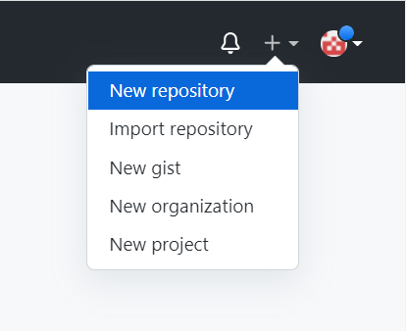
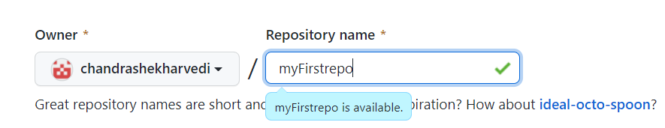
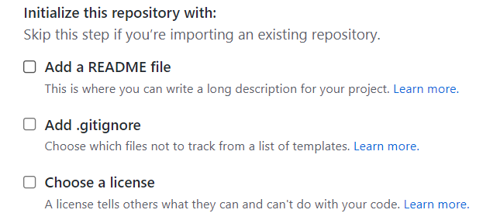
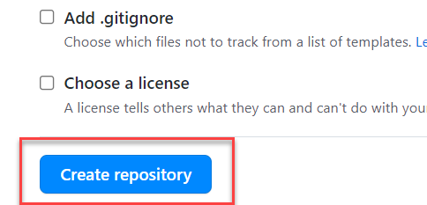
Steps to Create a new git Repository
Step by Step process to create a git repository in GitHub. First of all you must have a GitHub account, if not then go to this link https://github.com/signup?source=login and create a new Account.
Step 1: Click on the plus button in the top right corner of the screen and select ‘New Repository’.
Step 2: Type a short, memorable name for your repository. And give a description (optional).
Step 3: Select the type of repository. Public or Private
Step 4: Set how you want to Initialize the repository.
Step 5: Click on Create Repository. Your Repository will be created.
Repository Created Successfully

Slide 18
Adding project to git repository
Project on Local System
1
git init
Initialize a git repo
2
git add .
Stage all the changes
3
git commit –m “message”
git pull
Once the project is connected to git repo then we just use the git pull and git push commands to get the new changes and send our changes
Stage all the changes
git push
5
git add remote <repo URL>
Add the remote branch
GitHub Repository
git push
5
Clone repository for the first time in system
git clone <repo URL>
GitHub Repository

Slide 19

End of Day 12

Slide 20

Questions

Slide 21

Shekhar Vedi

Slide 22


We’re committed to empower you to be
Most Desirable Resource
through powerful training solutions.
We build the workforce of the future.
250+
Corporate Clients
30,000+
Learners Trained
25000+
Learners Placed
FREE WEBINARS
Sign up for free webinars with industry experts every fortnight!
Enroll Now!
Contact us today!
https://anubhavtrainings.com/

Slide 23




More from AnubhavTrainings.com

Slide 24
Title
Content

